Slide 1
Torbjørn Naimak, Regional Roads Director, Norwegian Public Roads Administration
NSPA Transport Seminar, 19th of November
National road 93

Slide 2
The content of this presentation
Joint Barents Transport Plan
International cross- border Cooperation
High North policy in Norway
BEATA follow-up work

Slide 3
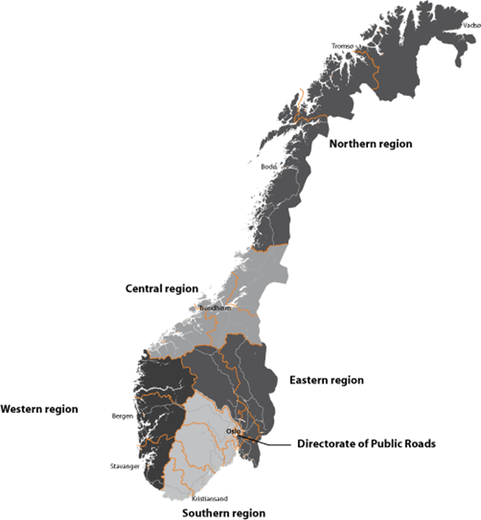
Norwegian Public Roads Administration
Northern region
3415 km of the European and national road
12 border crossings
Border towards three countries
The region is a major exporter of goods
long distances
Challenges related to weather and climate

Slide 4
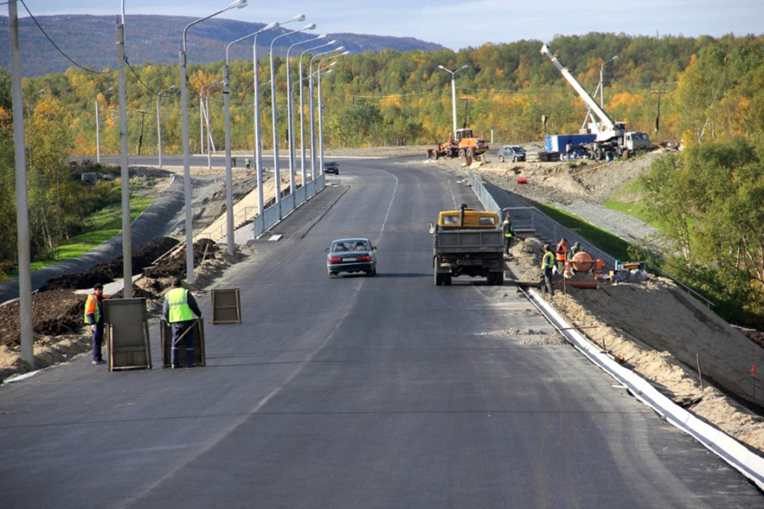
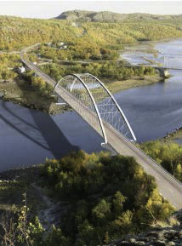
Long tradition of cooperation within transport and logistics
Bilateral cooperation,
Norway/Russisa (since 1990) Norway-Finland Norway-Sweden
The Nordic Road Association (NVF)
Barents meeting of regional road directors
EU-programmes
Northern Dimension Partnership on Transport and Logistics (NDPTL)
Barents-Euro Actic Transport Area (BEATA)
Barents Regional Working Group of Transport and Logistics (BRWGTL)
Road projects and cooperation
Barents trafic safety forum
E 105 – cross-border cooperation
17/11/2014
Notes:
Kolarctic ENPI
Barents Freeway (On-going project)
Northern Periphery Programme
Northern Maritime Corridor (2002-2008)
Baltic Sea Programme
Sustainable Transport in the Barents Area (STBR) (2002-2008)
4

Slide 5
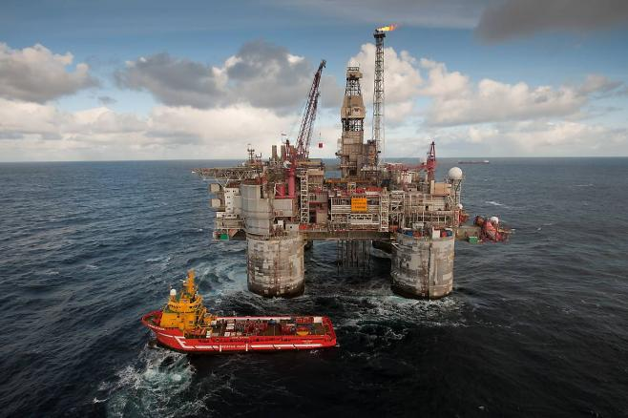
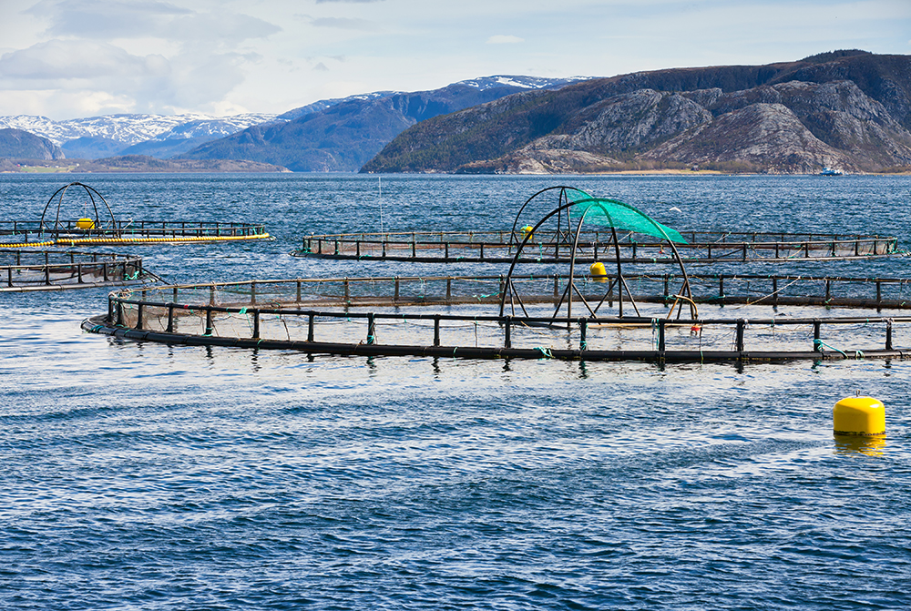
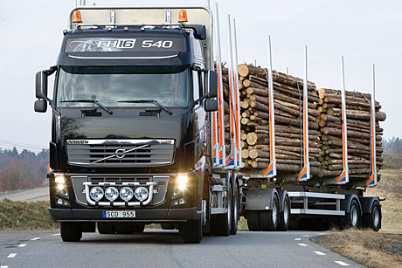
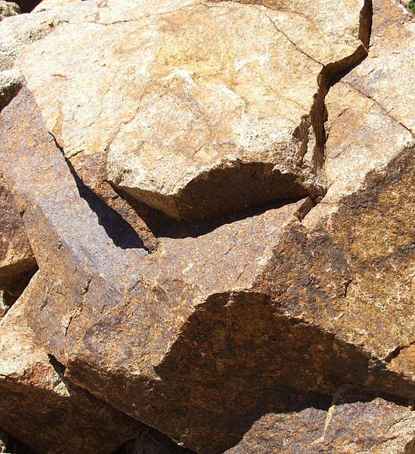
Development of industries in the high north – infrastructure matters!
17.11.2014

Slide 6
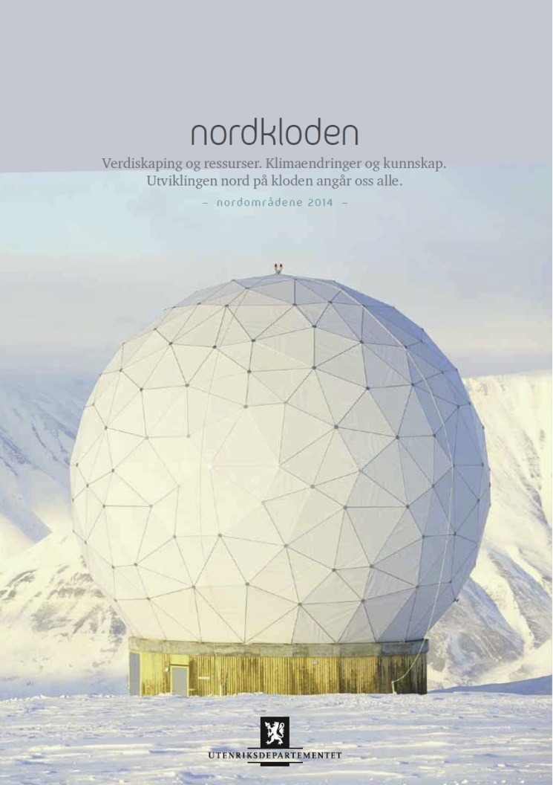
North Norway – a region in a state of growth
Prime Minister Erna Solberg
launched the Government’s status report on Norway’s Arctic policy 12 november.
She underlined four main reasons for an active policy to translate knowledge and resources into jobs and value creation
The world needs more energy
2. The world needs more metals and minerals
3. The world needs more food
4. The world wants to see northern lights, Arctic nature

Slide 7
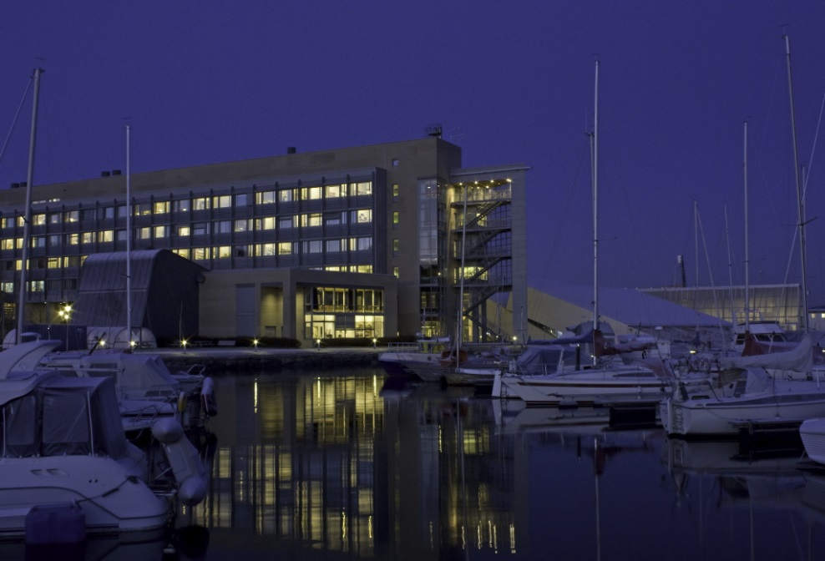
A region rich in natural resources
Mobility is of great importance!
Still of even greater importance;
Knowledge
People living in the north
World-leading research communities and cities

Slide 8
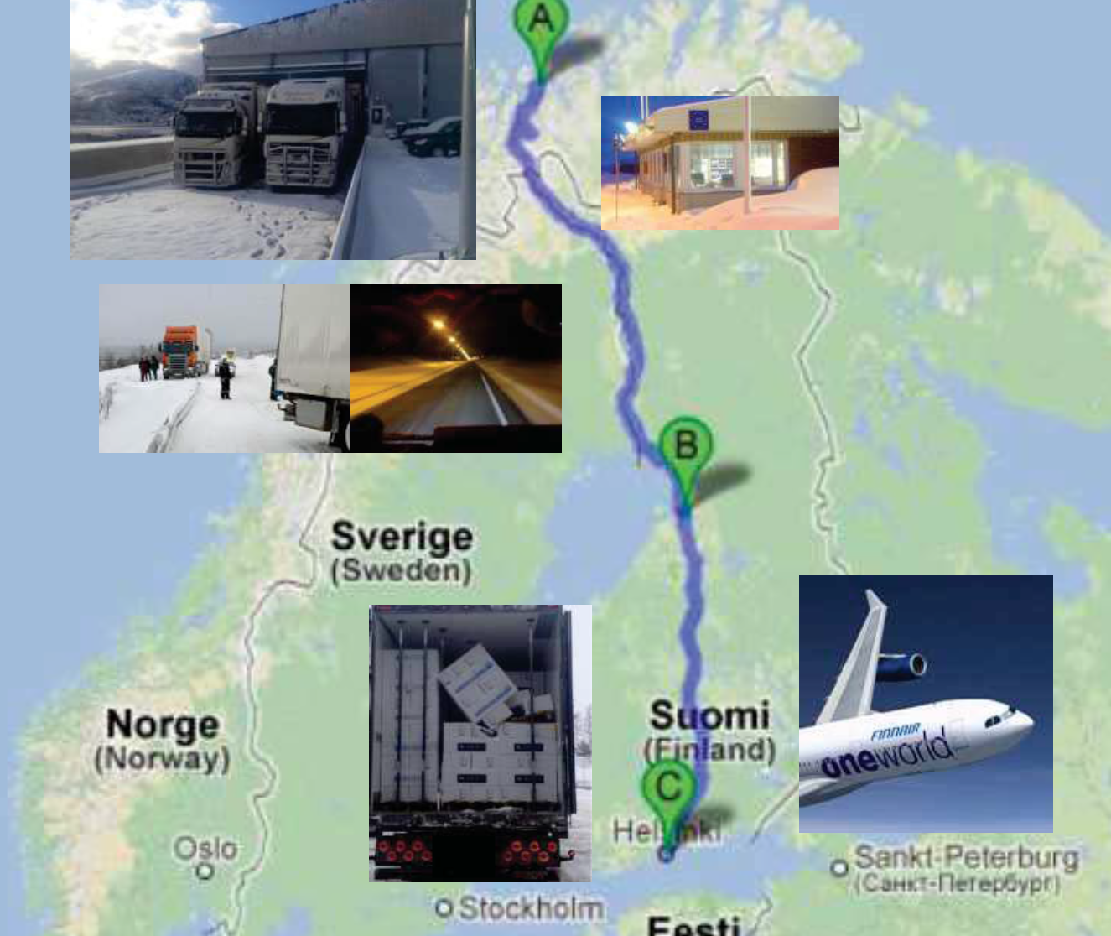
From Skjervøy to Japan in 36 hours
300 tonnes each day
16 trucks

Slide 9
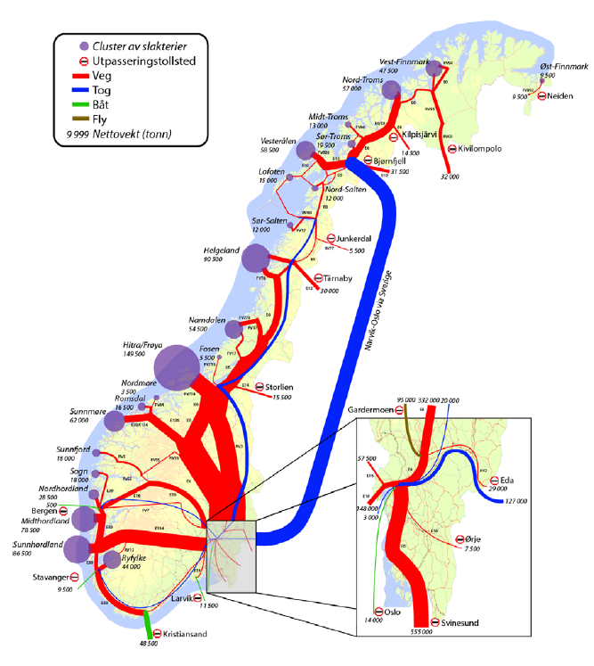
Transport of fresh seafood
Kilde: SIB 5-2014

Slide 10
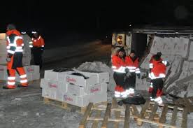
From sea to marked – common development of the whole corridor ?
Regulations
Information
Traffic safety
Planning
Maintenance
Rebuilding
Removal of bottlenecks

Slide 11
Need for harmonization of regulations

Slide 12
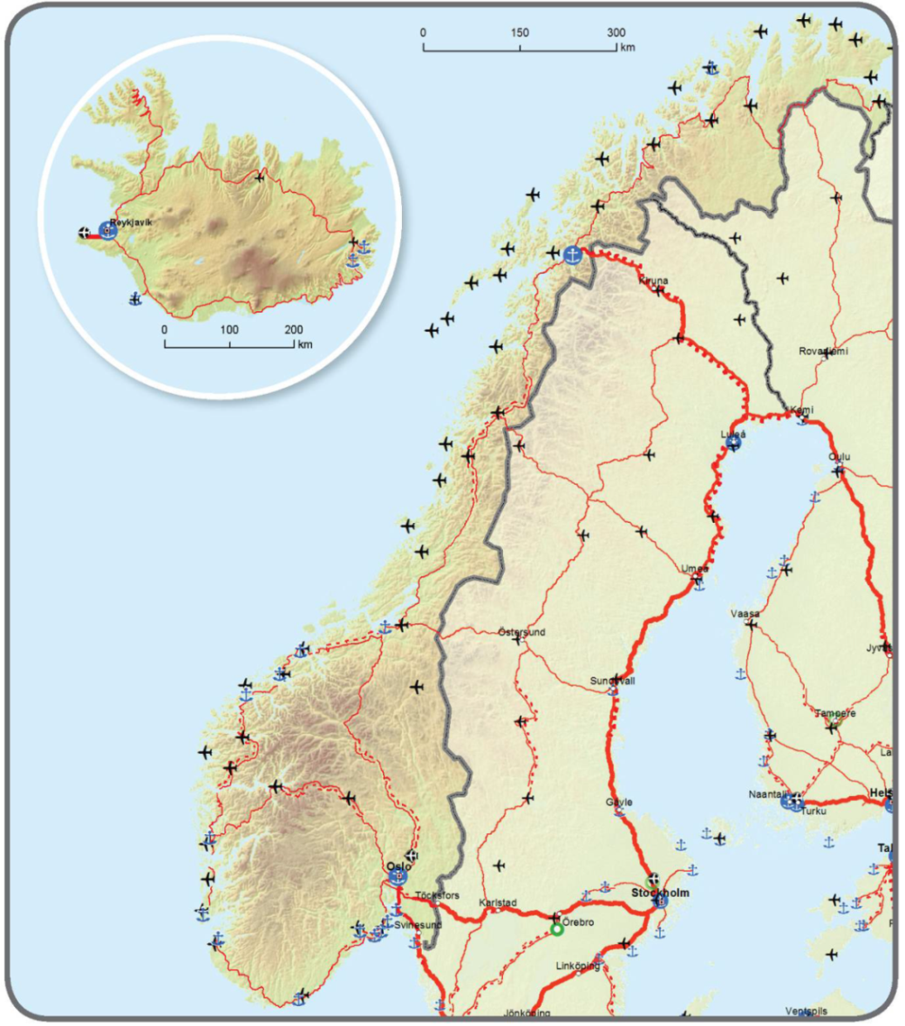
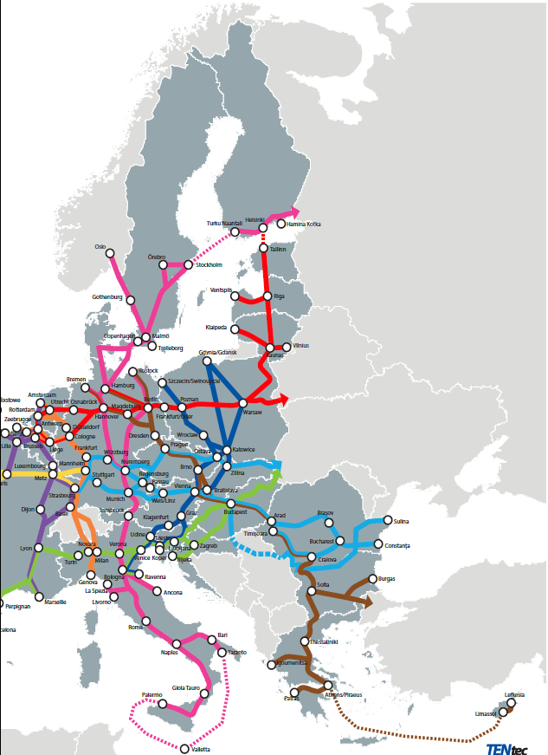
The Corridors of the Trans-European Transport Network (TEN-T)
Port of Hammerfest
Port of Narvik
Port of Mo i Rana
Notes:
«The core network corridors» er utvalgte deler av det definerte core network som EU nå igangsetter implementeringen av. Korridoren til Narvik, den Botniske korridoren og den nordlige maritime korridor er inkludert i Core Network, men ikke i de ni utvalgte korridorene som EU prioriterer i første omgang.
12

Slide 13
Denser and improved network needed
Need for a denser transport network in the Barents region to support regional development
Measures:
Improvement of existing corridors
Completion of missing links
Development of new corridors
Need for an efficient transport network connecting the Barents Region with Russia and EU
Transport corridors mapped will bring attention to development
Notes:
Finland allows the use of 76 tonne lorries on all roads. Sweden has allowed 90 tonne lorries on selected routes. Timber lorries up to 100 tonnes will also be tested on several routes in Finland. Norway recently permitted heavier lorriesto be used by the timber industry on selected routes, but only up to a maximum of 60 tonnes. Larger and heavier loads set new challenges for the load-bearing capacity of roads and bridges as well as road maintenance, especially in winter
Arctic winters and winter maintenance
Climate change- e.g more rain will challenge the way we construct and maintain the infrastructure --
13

Slide 14
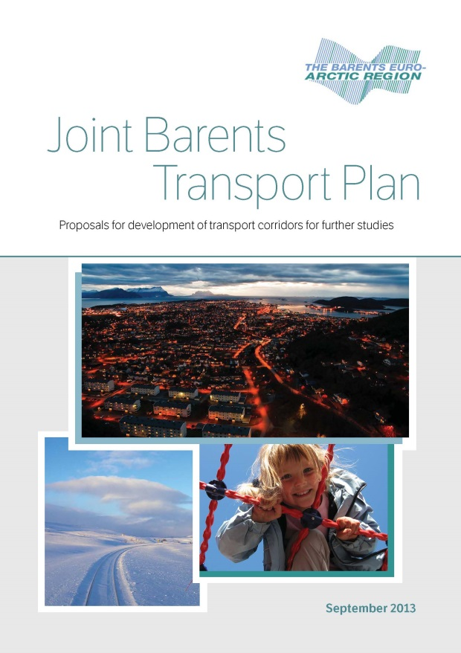
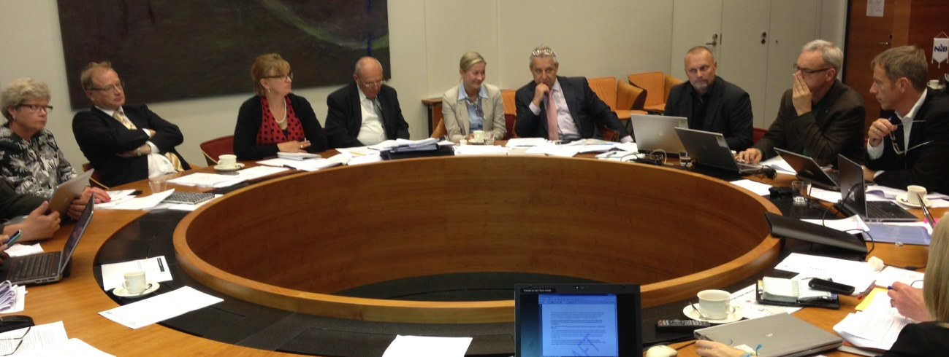
The first Joint Barents Transport Plan
11 experts from Russia, Finland, Sweden and Norway presented the proposal 24 September 2013
A ministerial declaration signed the same day agrees that the proposal can serve as input for cooperation on transport issues in Barents
Notes:
Si litt om bakgrunn, oppstart og tidsfase
14

Slide 15
Corridors defined in Joint Barents Transport Plan

Slide 16
Barents Seaports
Notes:
Murmansk is definitely the main Barents port and planned development is highly supported by the Expert Group. Also development of the Norwegian ports of Kirkenes and Narvik is emphasized by the Expert Group
The Expert Group do not go into detail on the Northern Sea Route to Asia, but stresses the impact a huge increase in sailings will have on development of transport infrastructure in the Barents region. This is of course first of all related to development of the ports, but very much also on railway connections to relevant ports. Finnish mining industry is keen to have railway connections to either Kirkenes or Murmansk in case the Northern Sea Route becomes a competiple option for cargo to Asia

Slide 17
Flight connections
Notes:
The transport plan also looks into the challenges of lacking east-west flight connections, more information about this can be found in the document.
North-South, Travels are made mainly via the capitals in the countries - Give an example for attending a meeting in e.g Rovaniemi?

Slide 18
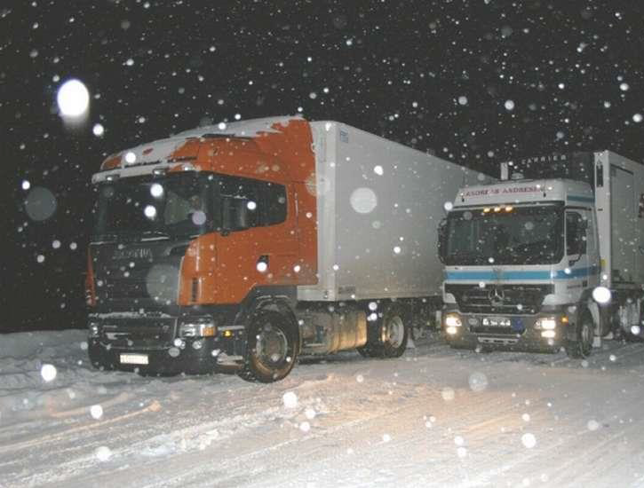
Proposed measures all modes
Removal of bottlenecks road, sea and rail
Harmonizing:
vehicle sizes
road standards
Asphalted road width of min. 8 metres
Development of key ports
Safety at Sea
Rail gauge difference
Notes:
Road:
Unsatisfactory road standard
Narrowness (Width Luleå-Narvik 6-13 m)
Sharp curves and steep slopes
Regularity and maintenance
Mountain passes; road closure or convoy traffic
Avalanche or falling ice proplems
Slippery road surface; reduced speed, or traffic flow on the road stops due to problems with other vehicles
Bearing capacity during spring thaw
Problems of traffic regularity due to precipitation and flooding (increasing problem)
Road closure entails long detours
Customs office
Different vehicle regulations in Sweden and Norway
Sea:
The Expert Group points to a number of measures to increase safety at sea and propses that a custom-made system for safety at sea should be implemented for these particular waters
Rail:
Gauge challenge no easy to solve
Capacity

Slide 19
Proposals
Common strategies for developing cross-border corridors
Common rules, harmonization of standards
Technical aids facilitating traffic
Joint planning
Improved infrastructure
Removal of bottlenecks

Slide 20
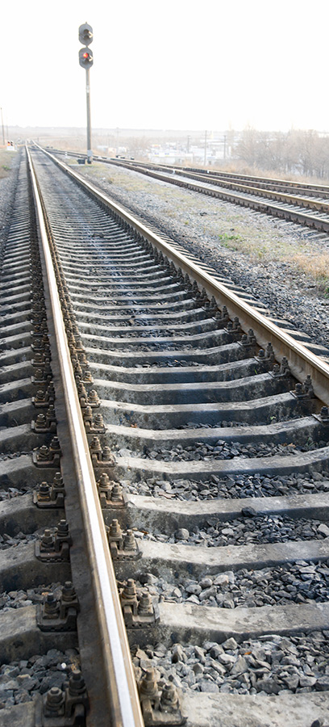
Proposed measures rail
New railway line between Nikel and Kirkenes with Russian gauge – consider studies
New railway line between Svappavarra (Sweden) to Kolari (Finland) - consider studies
New railway between Rovaniemi and Kirkenes via Sodankyla – further studies
Salla – Alakurtti considerations on construction of the missing railway connection in corridor Kemi –Kandalaksha – Murmansk
Full double track solution for railway between Norway and Sweeden- continue cooperation
Notes:
In a long term perspective the Expert Group proposes the following measures for rail transport:
For more detail on these proposals and the complete proposals please look into the Joint Barents Transport Plan.

Slide 21
Follow-up of the JBTP
Cooperation between transport authorities e.g on spesific corridors
BEATA and Finnish Chairmanship
New working group on corridors ( Autumn 2015)

Slide 22
Ongoing and future common projects
NDPTL – 2 applications
ENI- LIP Programme (preparations for project to be proposed)
Kolarctic project (traffic safety project)

Slide 23
Need for developing common cross-border stategy
E12 - stratgic study of measures
Ofotbanen/Malmbanen
E8 Muonio – Skibotn
NR 93 Palojoensuu –Alta
NR 971 Kamaanen – Kirkenes

Slide 24
Moving foreward -summary
Common mapping of the corridors and important transport hubs
More knowlegde about the strategic importance of brigding the high north
Connecting the regions through developing an integrated and strong network
Harmonization
More cross-border cooperation
Arctic know-how
Notes:
1) BEATA 2) NDPTL 3)TEN-T 4)Finsk-norske korridorer

Slide 25
Thank you for your attention!

