Slide 1
TEN-T in the North and the Bothnian corridor
Mr. Juhani Tervala, Finnish Transport Agency

Slide 2
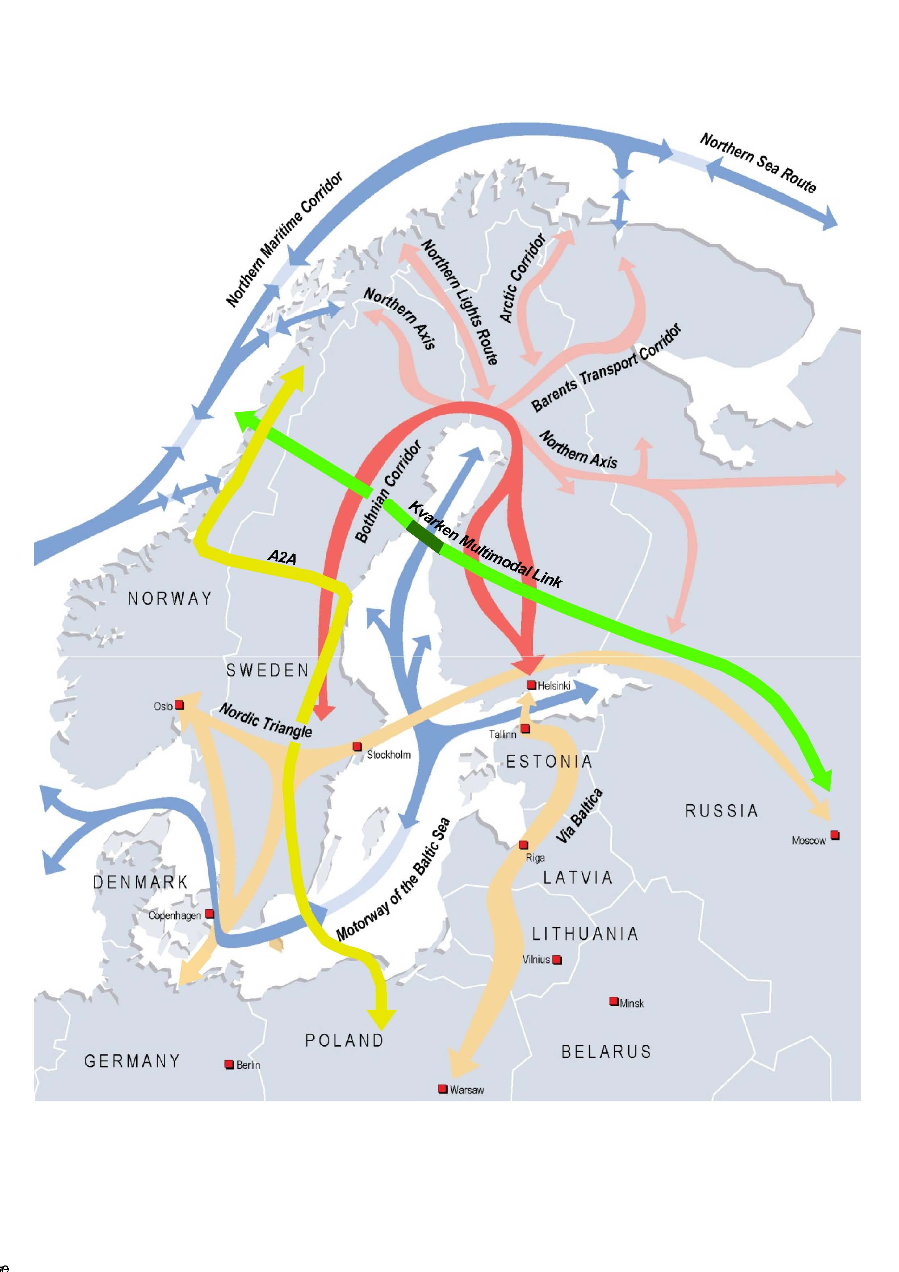
Connections

Slide 3
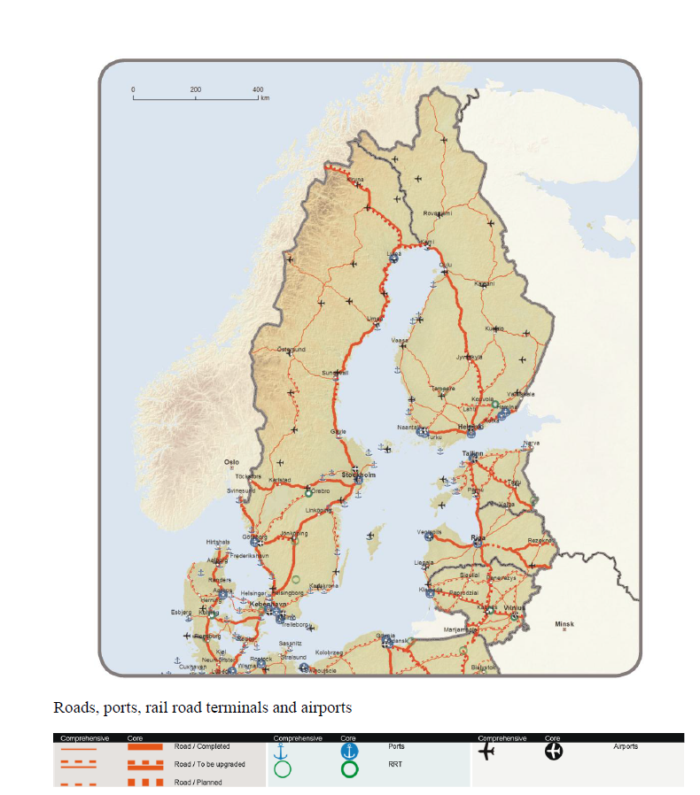

Slide 4
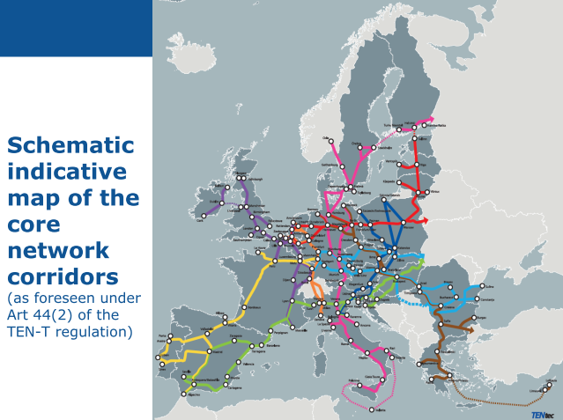

Slide 5
Transport System in the North
Area is sparsely populated and there are large distances between urban areas,
Volumes are low, distances are long, road traffic dominates,
It is more offering connections than managing large volumes or congestion,
Long networks and low traffic volume challenge maintenance and development,
Logistic costs are high, because long distances,

Slide 6
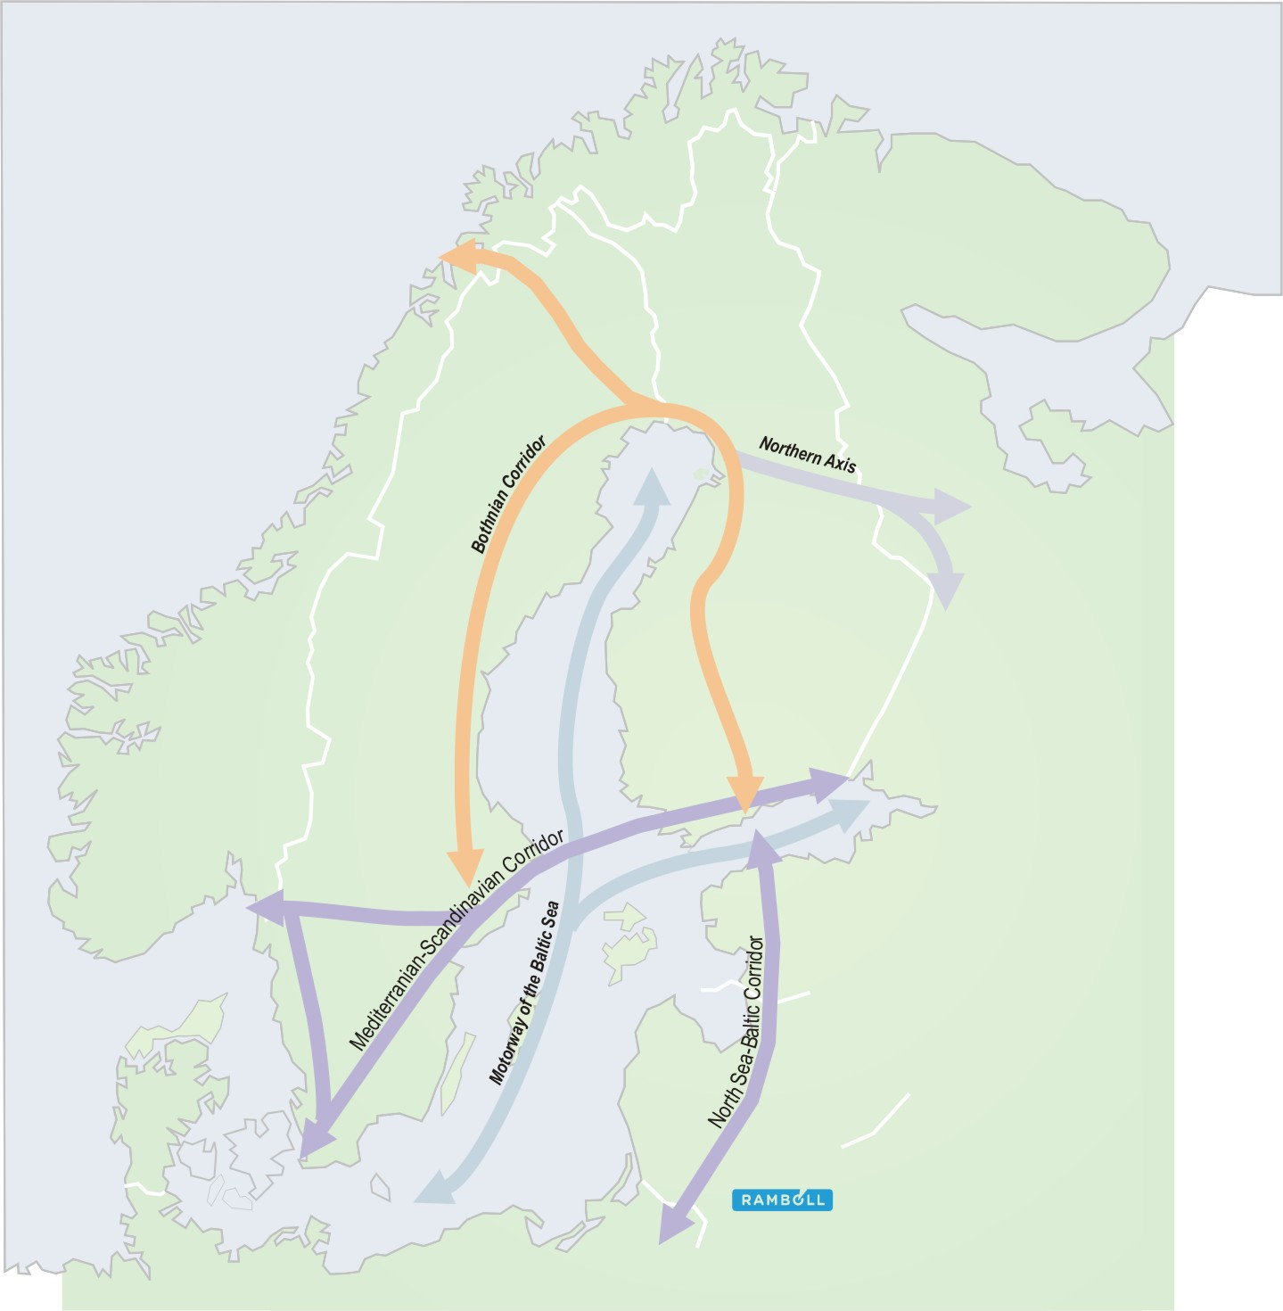
FINN-CORRIDOR
FINN-CORRIDOR between Nortern Axis and Core Corridors
  mainrail Helsinki–Kemi–Tornio
    Rails 810 km
    Fourrails 3 %
    Two rails 30 %
    One rail 67 %
  vt 4 Helsinki–Keminmaa ja vt 29 Keminmaa–Tornio
    Roads 730 km
    Motorways 30 %
    Semimotorways 5 %
    Other roads 65 %
  Saimaa lake area c. 780 km

Slide 7
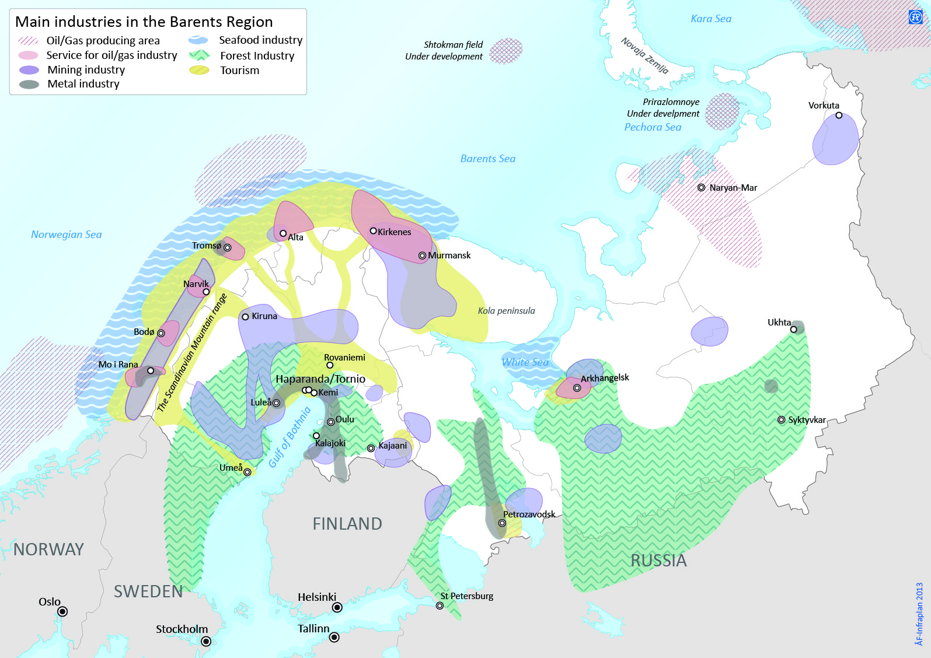
Barents Region – European High North

Slide 8
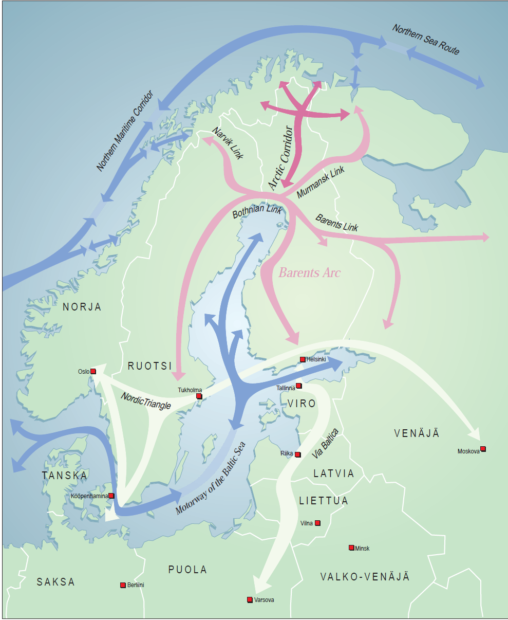
EUROPEAN HIGH NORTH
We need links to the Artic Europe to the deep-water ports of the Arctic Ocean, large production areas of oil and gas industry and the western end of the Northern Sea Route

Slide 9
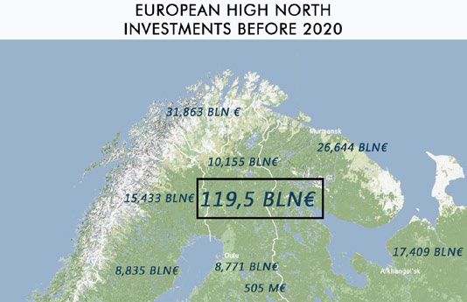
1. Wind power: € 21,4 billion
2. Oil & gas: € 16,8 billion
3. Logistics: €14,6 billion
4. Mining: €13,1 billion
Source: Chamber of Lapland

Slide 10
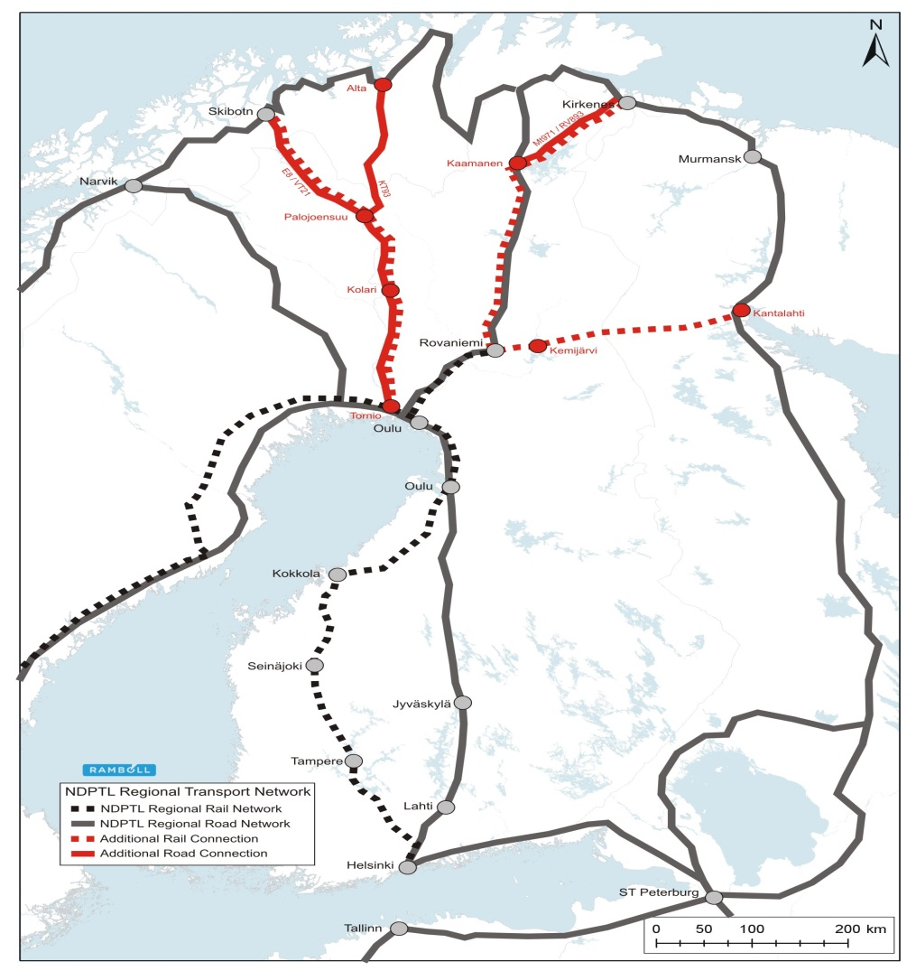
NDPTL Regional Transport Network
Additional connections to the NDPTL Regional Network
Railways
  Existing railways
  Tornio–Kolari
  Rovaniemi–Kemijärvi
  Proposed new railways
  Rovaniemi–Kirkenes
  Kolari–Skibotn
  Kemijärvi–Salla–Kandalaksha
Roads
  E8 Palojoensuu–Skibotn
  Road 93 Palojoensuu–Alta
  Road 971 / 893 Kaamanen–Kirkenes

Slide 11
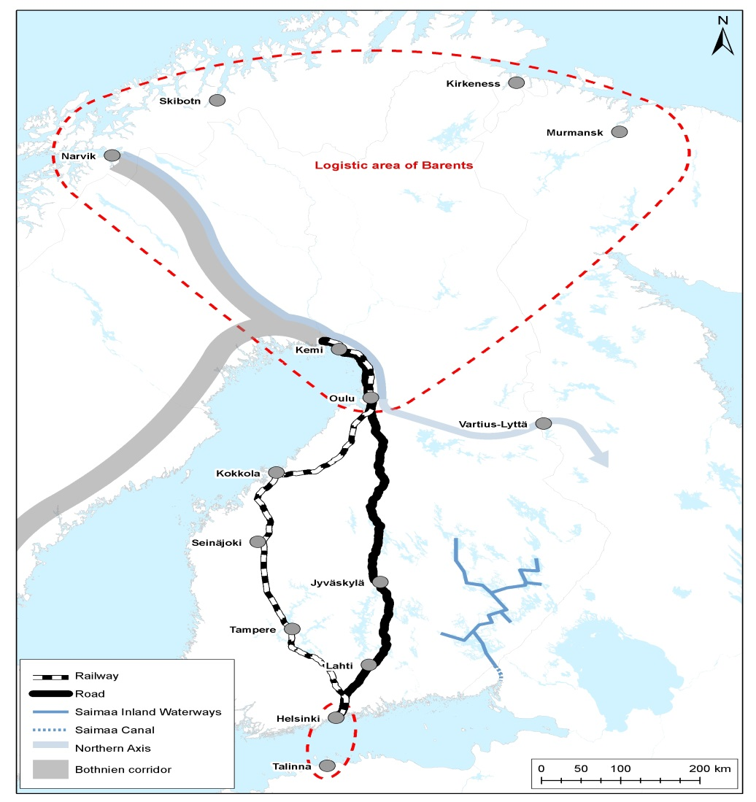
Barents Logistic Area
  Main ideas
  to develop exixtings roads/rails
  to develop air-conections

Slide 12

HOW TO CONTINUE

