Slide 1
An Industry perspective: transport infrastructure - Key to sustainable growth
Mette Hartzell,
EU Public Affairs Manager LKAB S.A.
19 November, 2014

Slide 2
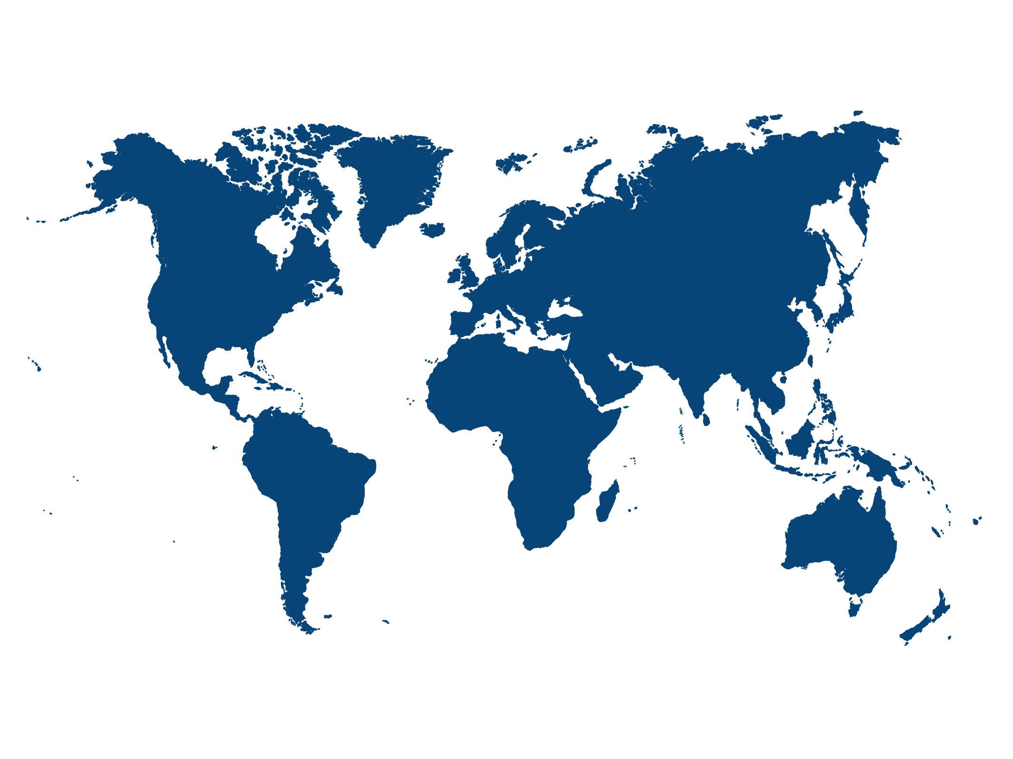
LKAB IN SHORT
Mining since 124 years
Mainly Arctic operations
Climate-smart iron ore pellets
4,400 employees
85% of the EU’s iron ore production
Major investor: € 6 billion during 10 years
Aim to grow

Slide 3
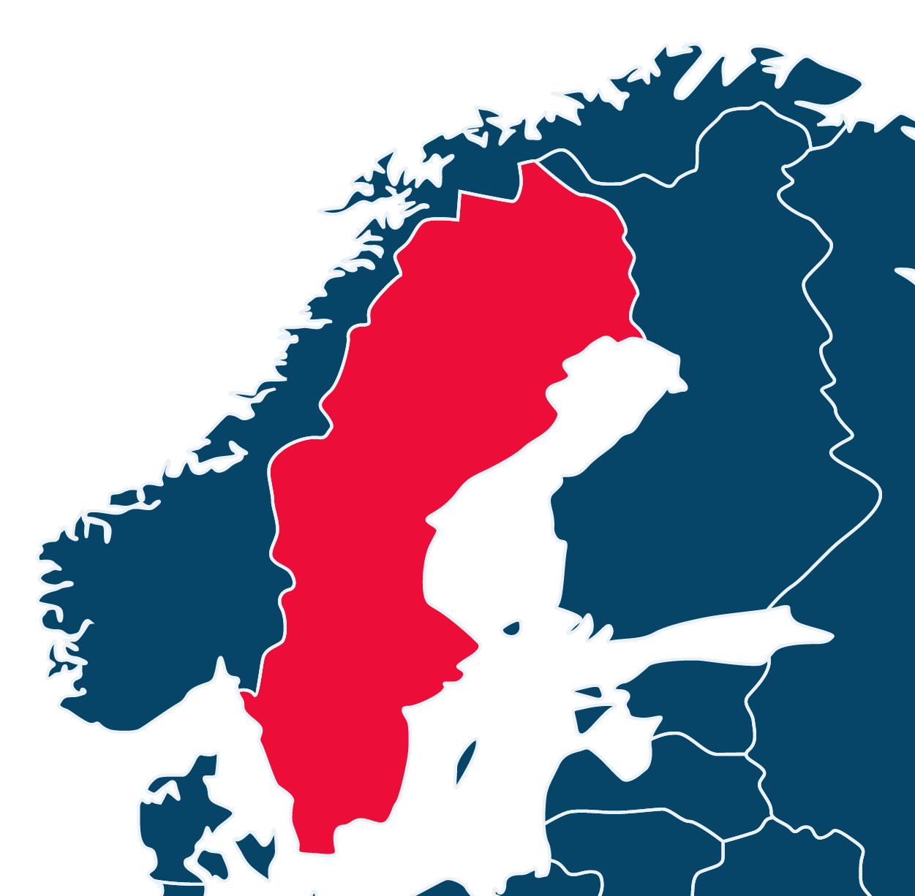
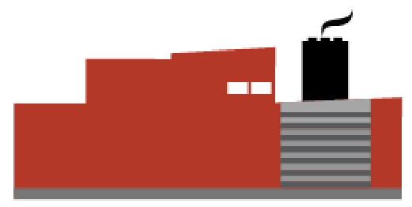
Kiruna
Narvik
LKAB Logistics
Svappavaara
Malmberget
Luleå
Stockholm
IRON ORE OPERATIONS

Slide 4
narvik port
Depth: 27 m
Ships/Year: About 200
Volume/Year: 19 Mt
Destinations: Europe, MENA, USA, Asia

Slide 5
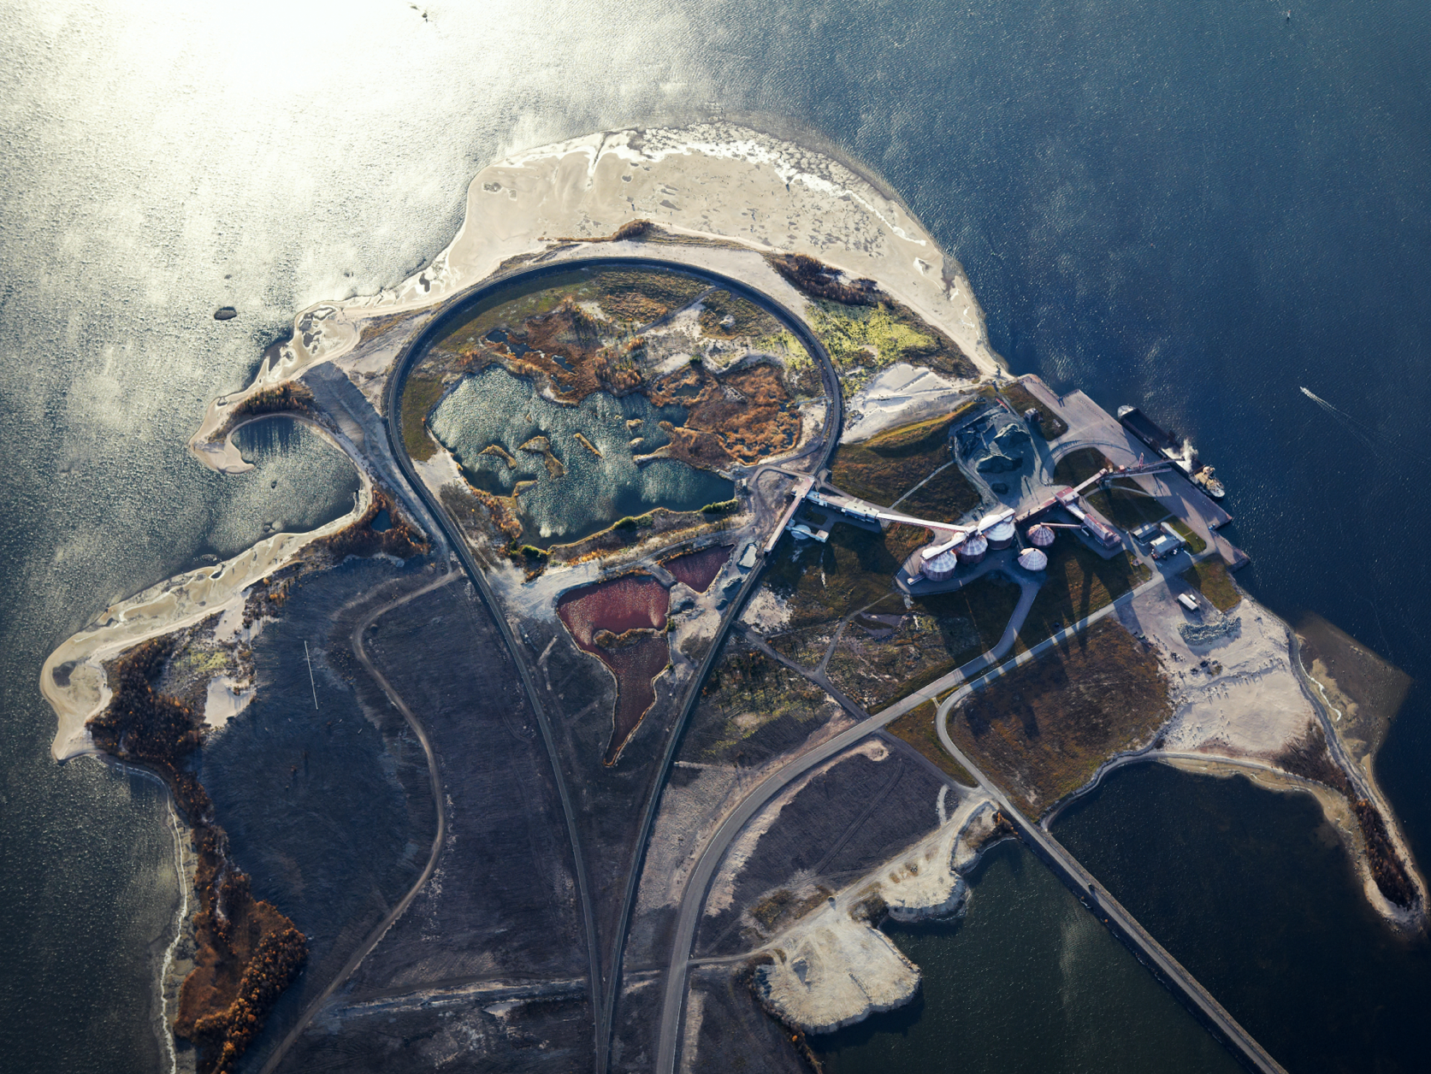
LULEÅ port
Depth: 12 m
Ships/Year: About 440
Volume/Year: 6 Mt
Destinations: Sweden and Northern Europe

Slide 6
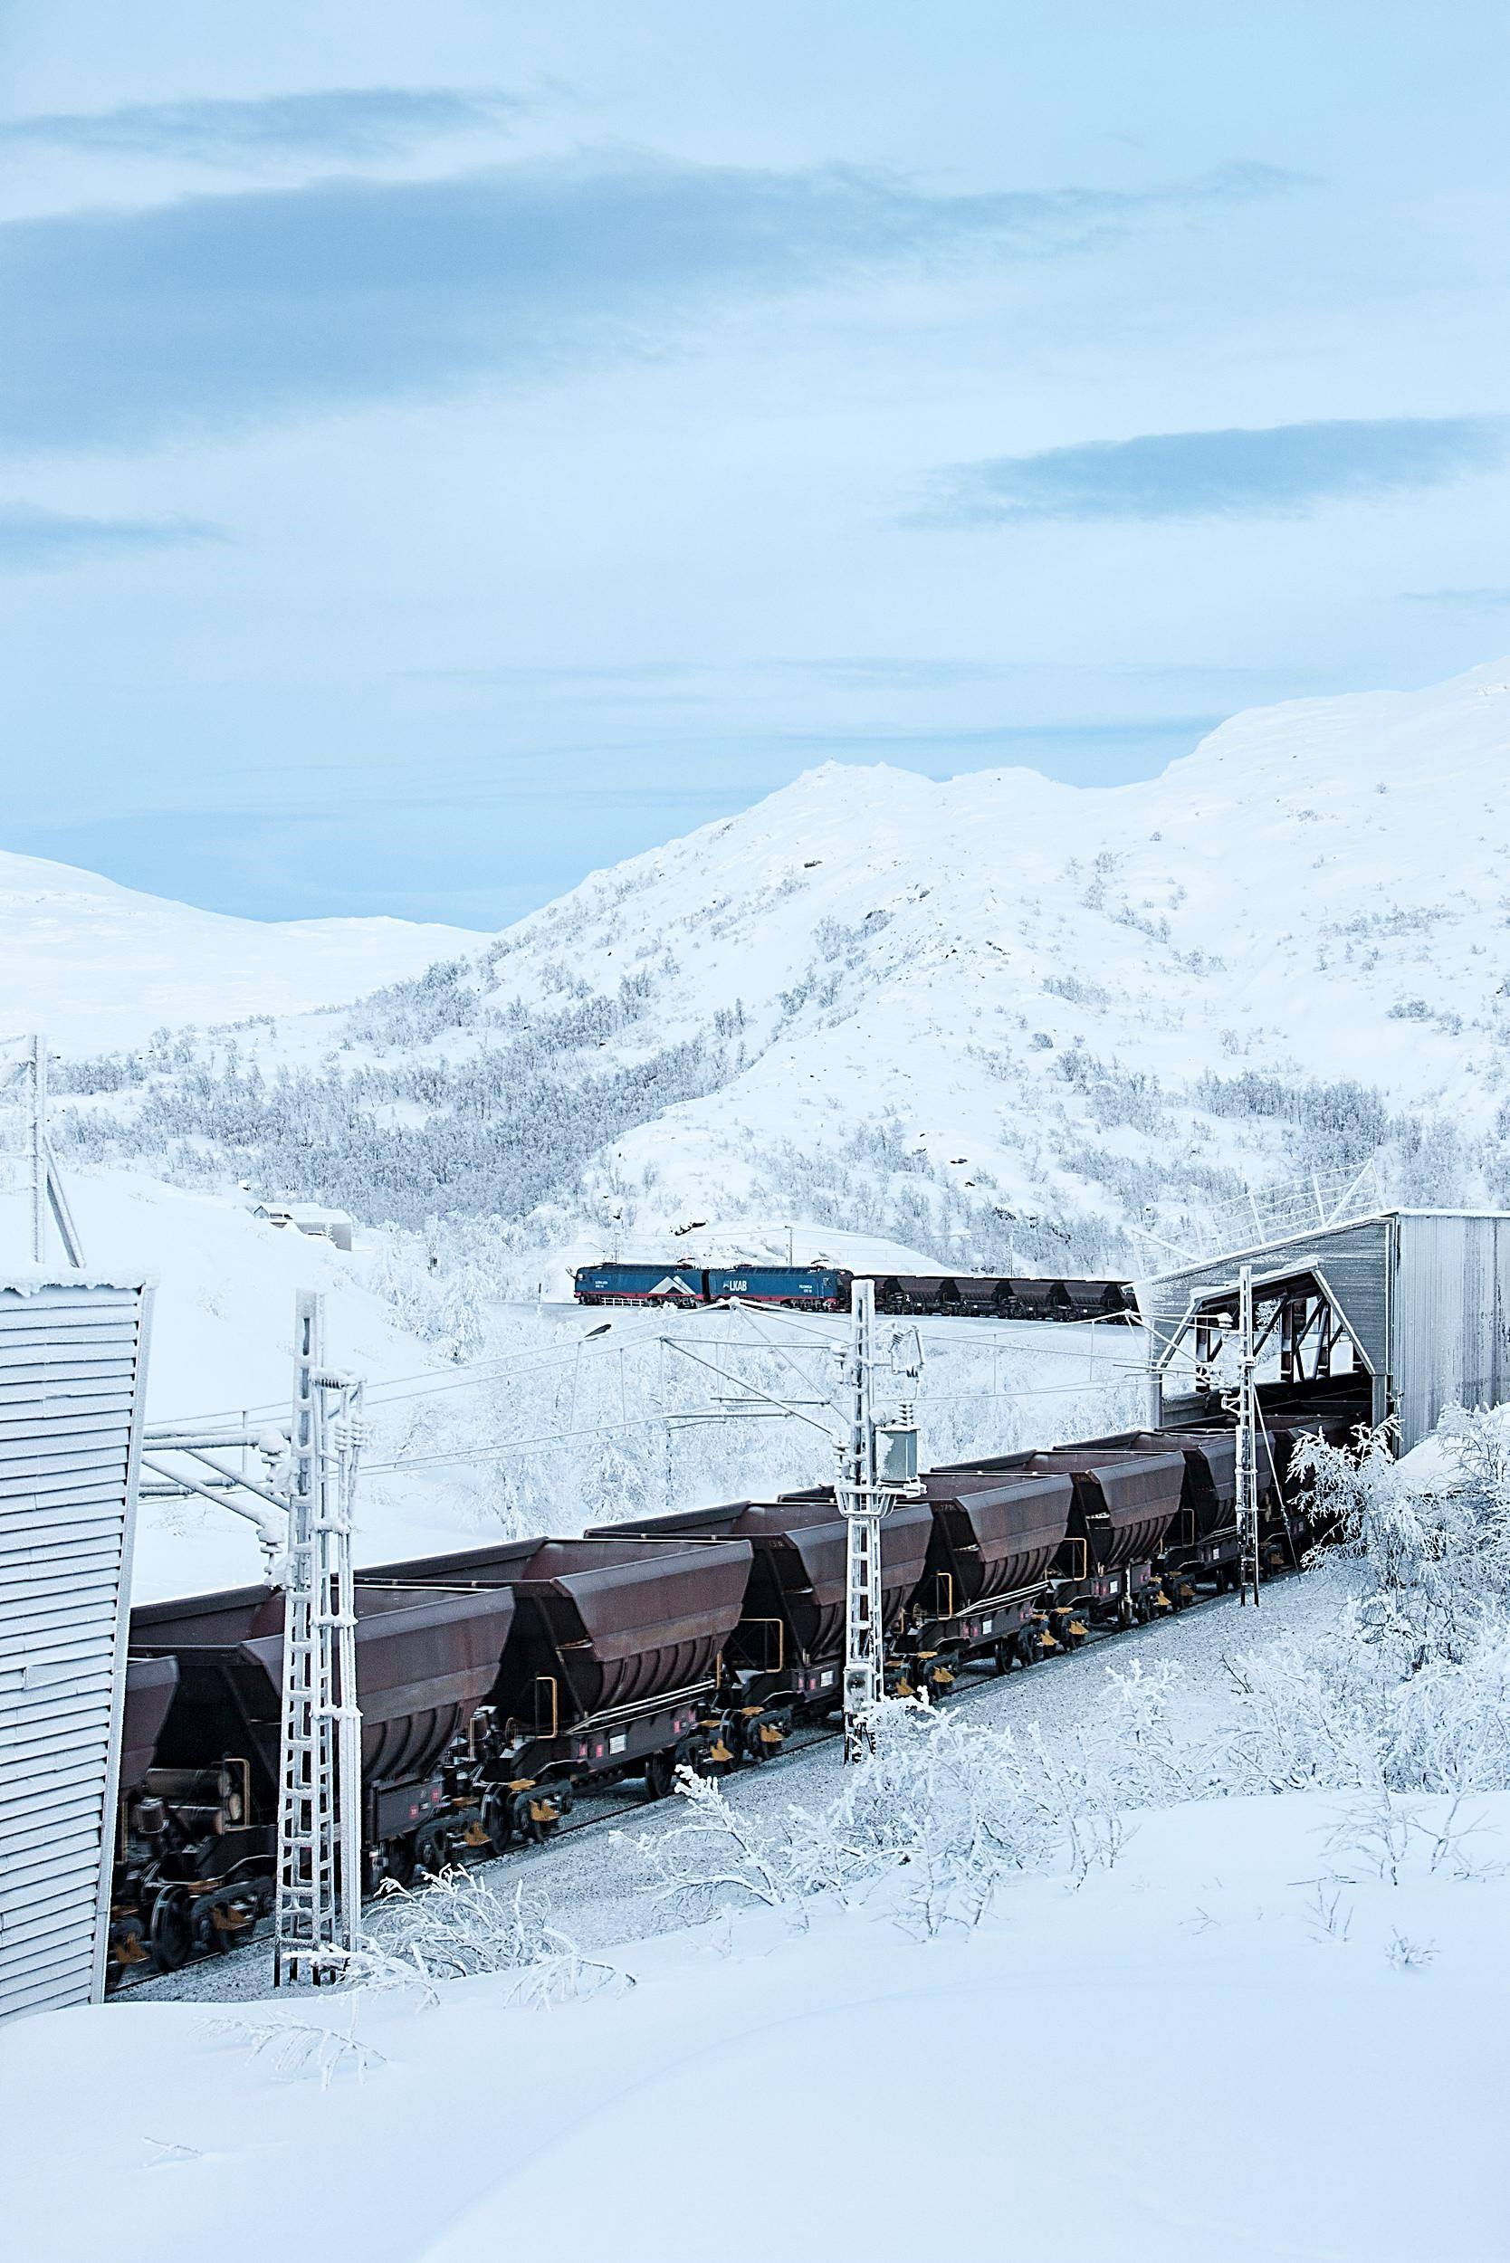
LKAB has invested > €500 million in a new logistics system
Increased cargo weight 30 tonnes axle load
Uniform locomotives and ore wagons
Only long trains - 750 m
Efficient terminals and ports
Efficient maintenance workshops

Slide 7
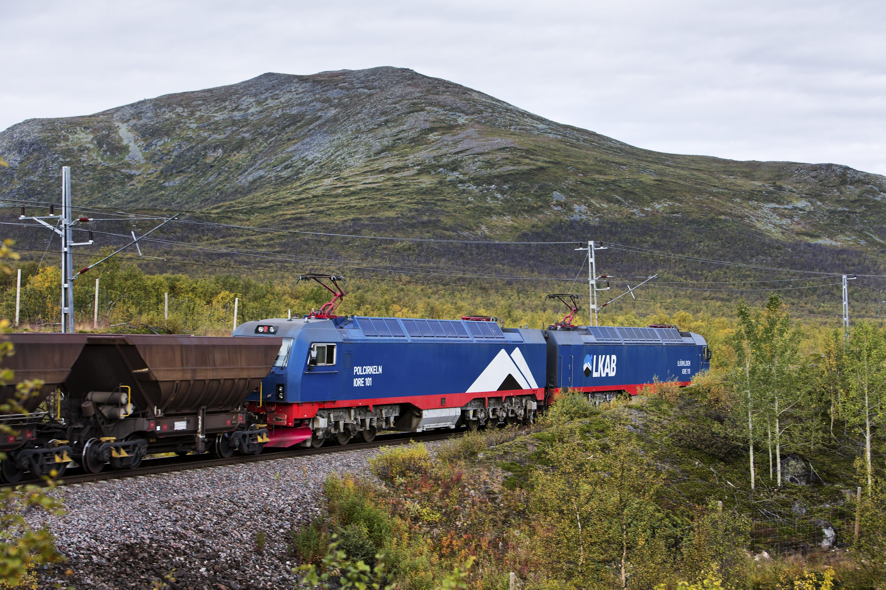
IORE Locomotive

Slide 9
eHighway

Slide 10
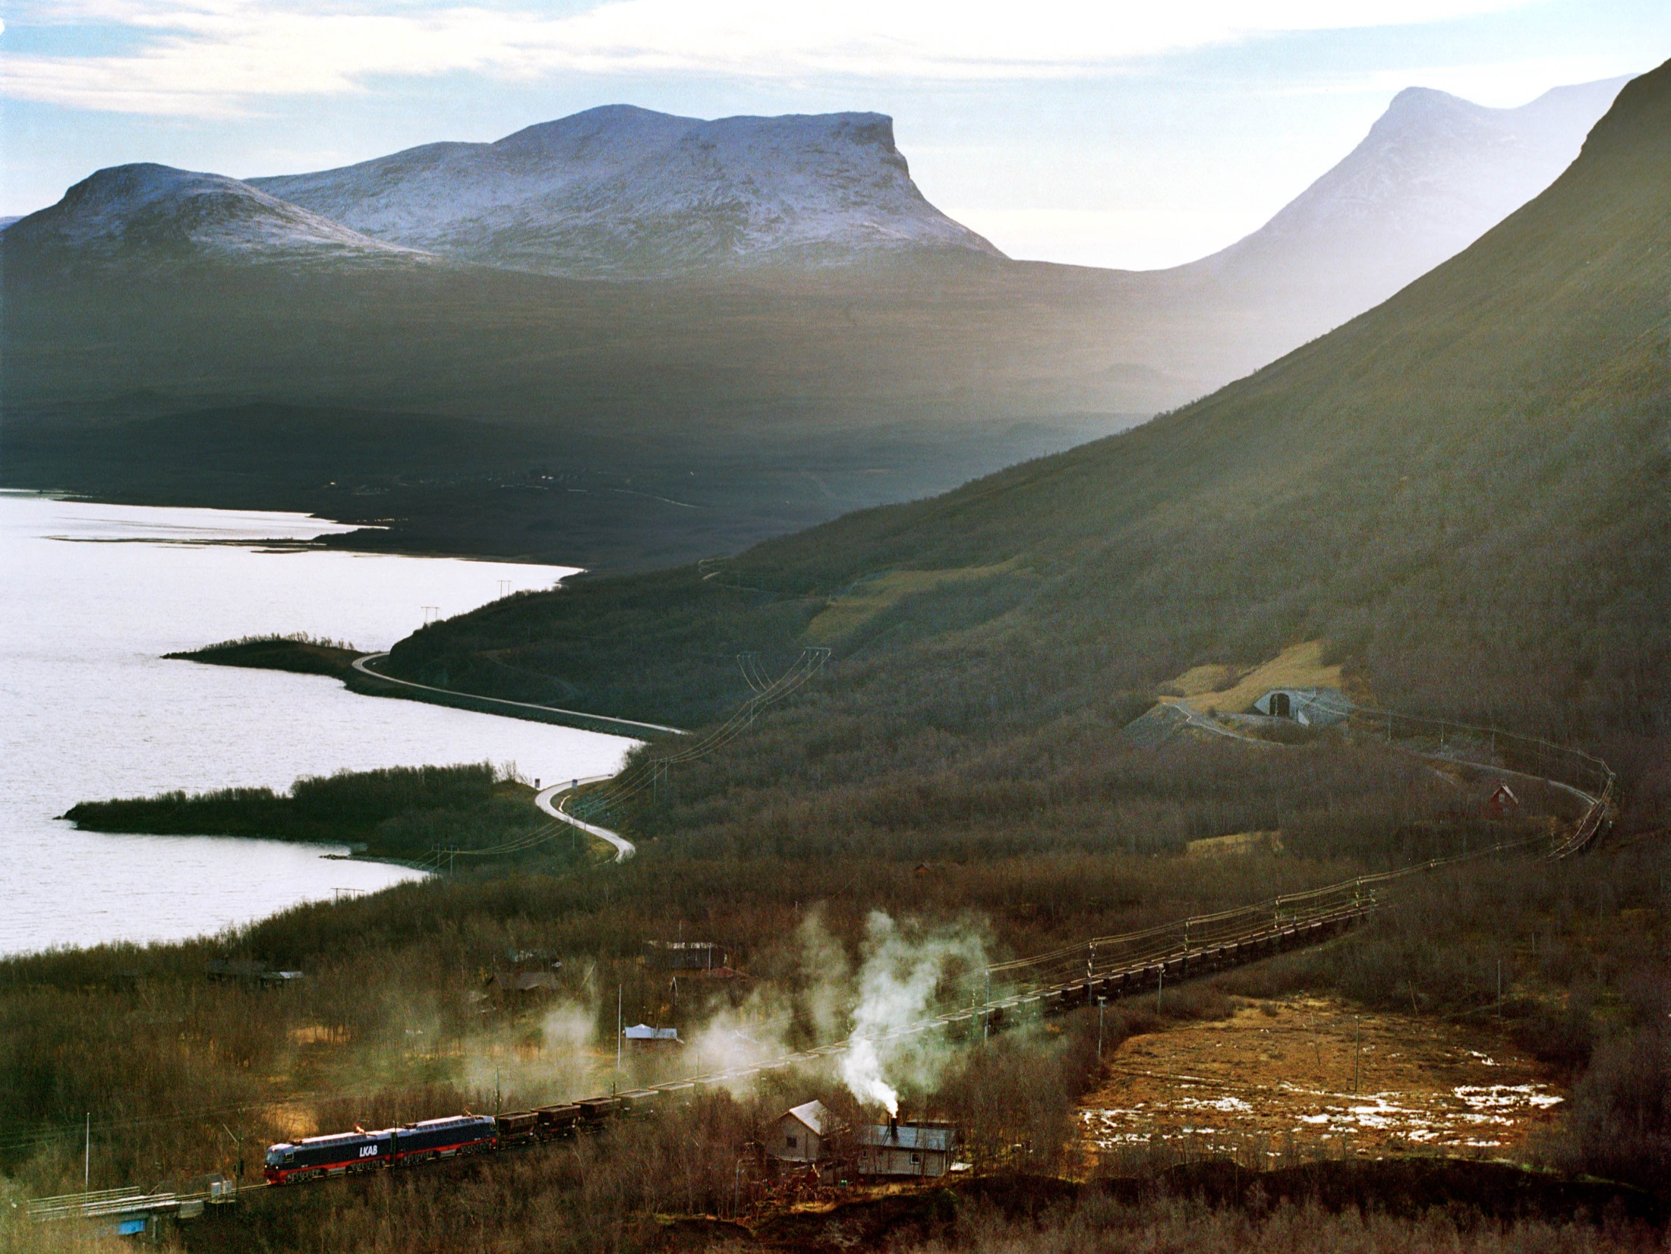
Infrastructure development is key to sustainable growth

